Slide 1
UNIT 2
Java Servlets
Practice Servlet-based application
Rubén Peredo Valderrama
ESCOM – IPN, México
rperedo@ipn.mx

Slide 2
Practice Servlet-based application
Login with servlets and database.

Slide 3
Practice
Description:
Build a Web application that implements a login with servlets and database.

Slide 4
Practice
The following figure shows the interface of the Web application.

Slide 5
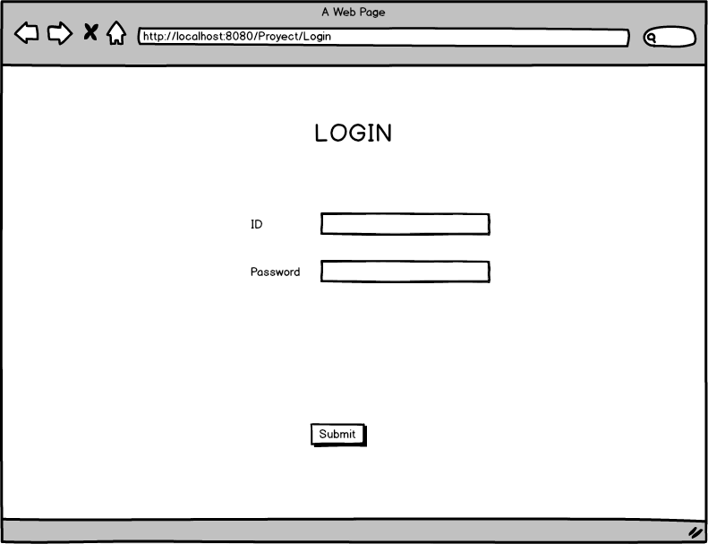
Practice

Slide 6
Practice 4
A user registered in the database by entering an ID and password will get the following figure.

Slide 7
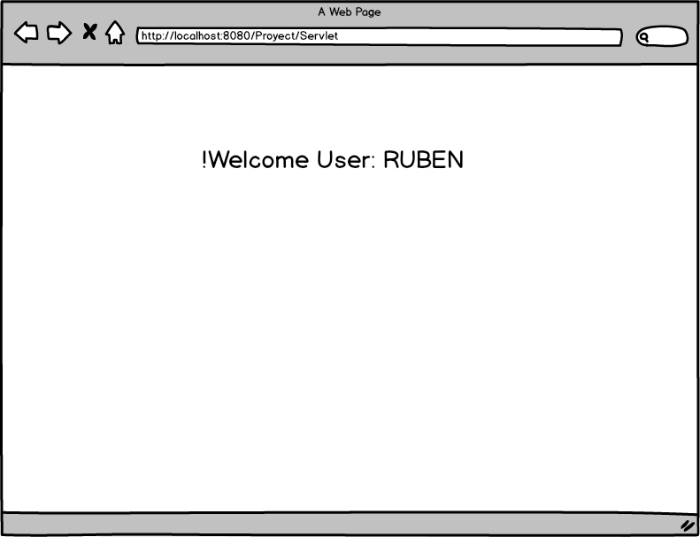
Practice 4

Slide 8
Practice
An invalid user in the database by entering the system by entering an ID and password will get the following figure.

Slide 9
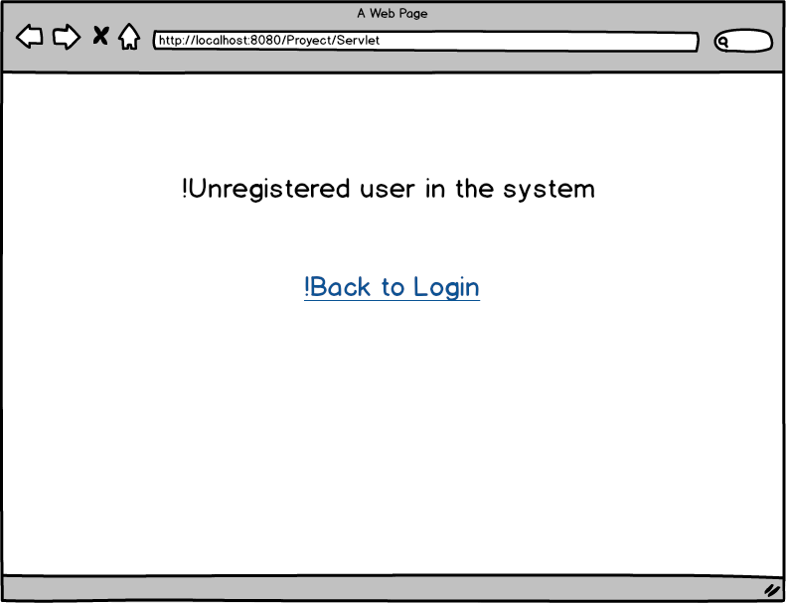
Practice

Slide 10
Practice – DataBase
CREATE DATABASE BaseAutocompletado;
use BaseAutocompletado;
SET FOREIGN_KEY_CHECKS = 0;
CREATE TABLE Palabra(idPalabra INT NOT NULL AUTO_INCREMENT, texto VARCHAR(10) NOT NULL,
PRIMARY KEY(idPalabra));
SET FOREIGN_KEY_CHECKS = 1;
GRANT ALL ON BaseAutocompletado.* TO admin@localhost IDENTIFIED BY 'adminAuto';

Slide 11
Practice – DataBase
INSERT INTO Palabra(texto) VALUES('Abe');
INSERT INTO Palabra(texto) VALUES('Abel');
INSERT INTO Palabra(texto) VALUES('Abigail');
INSERT INTO Palabra(texto) VALUES('Abner');
INSERT INTO Palabra(texto) VALUES('Marcy');
INSERT INTO Palabra(texto) VALUES('Marge');
INSERT INTO Palabra(texto) VALUES('Marie');

